Slide 1
SmartOFF
Power Supply Management of Appliances for Energy Conservation
Nishant Borude - 111447198
Bhushan Sonawane - 111511679
Ishupreet Singh - 111424300

Slide 2
The Problem
Power consumption in standby mode
A Machine Learning and IOT approach
Identify behavioral pattern of the user to control the devices’ power supply
Lots of savings
The main challenge is to use one main grid for all

Slide 3
Machine Learning
Supervised Learning - SVM, Neural Networks as base case
ARIMA for appropriate time series forecasting

Slide 4
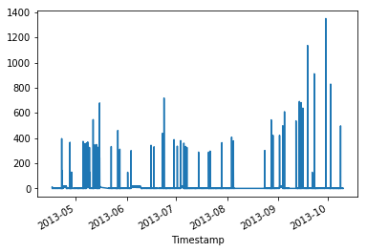
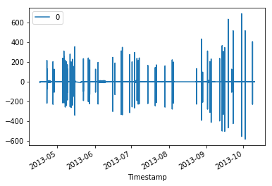
Data Visualization

Slide 5
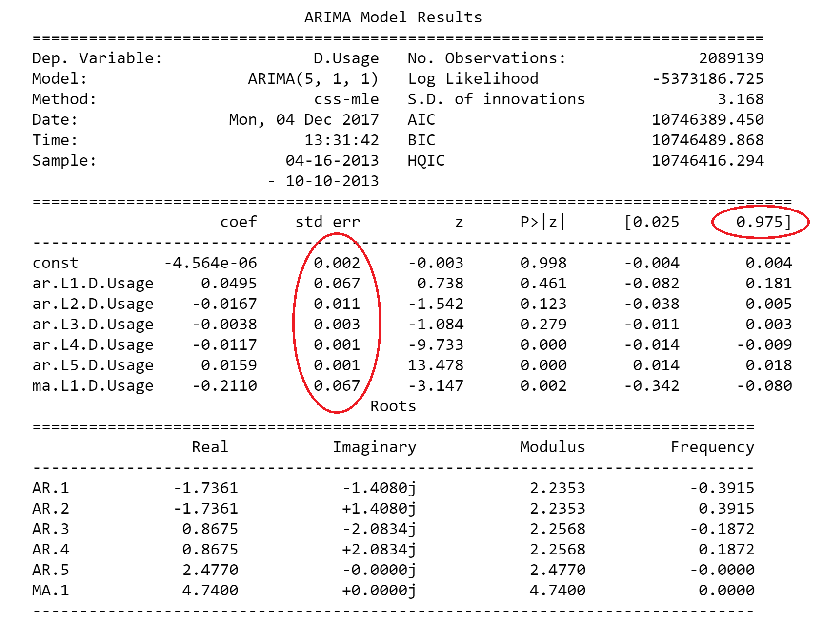

Slide 6
How do we use LSTM?
Parameters
Month, Day, Hour, Minutes, Seconds
Max normalized
API used
Keras, Scikit-learn
LSTM Model
50 LSTM cells
1 Dense layer
5-10 Epoch
Appliances trained on
TV
Microwave

Slide 7
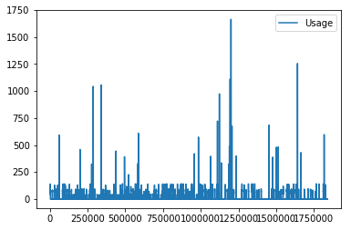
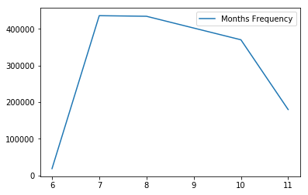
Data analysis for primary TV

Slide 8
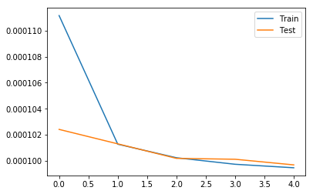
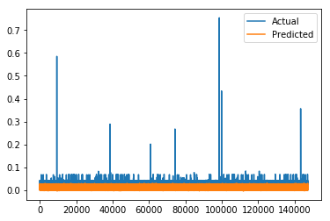
LSTM for TV - RMSE = 0.000107

Slide 9
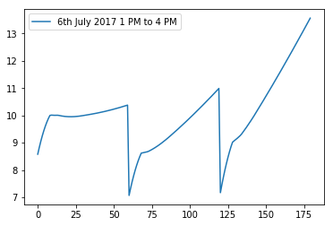
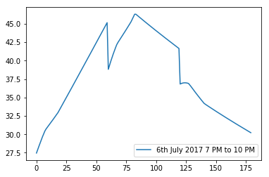
LSTM - Prediction on TV
X Axis: Minutes from base time
Y Axis: Prediction in Watts

Slide 10
How do we control the actual device?
Two modes of operation:
Configuration mode.
Operation mode
Notes:
Configuration mode: Which WiFi Network to connect to. In this mode only one connection is allowed to the device. The reason is key sharing. Else Man in the middle attack is possible. Once the key is shared with the esp8266 then all the communication that happens is encrypted. We made a protocol for communication between these devices.
Operation mode: This mode is the general operation mode in which the user or the AI can communicate with the switches.

Slide 11
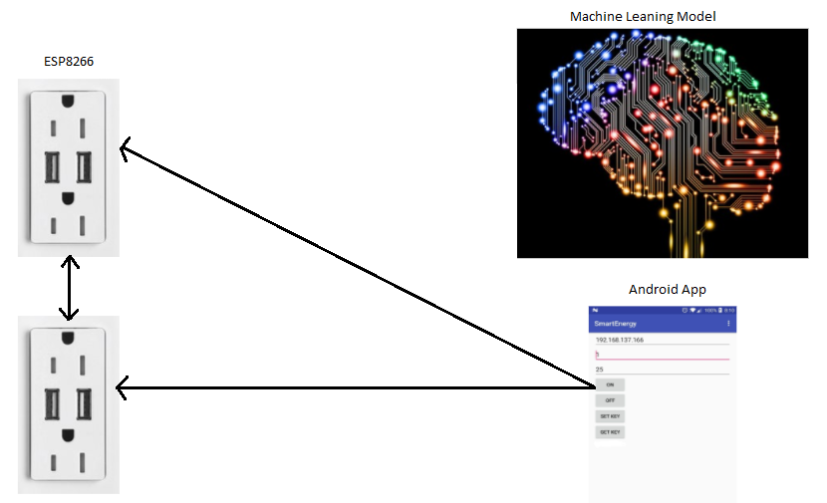
How do we control the actual device?
Configuration Mode
Notes:
In the configuration mode, we setup the ESP8266 microcontroller which sits behind the socket and controls the switch.
Connects to only one client to send the symmetric encryption key. This prevents Mitm during key exchange
Also add a random initialization vector so that every communication has a different cipher text
All this makes the communication secure

Slide 12
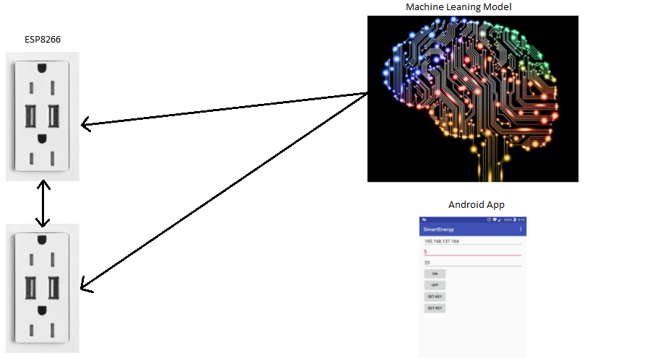
How do we control the actual device?
Operation Mode
Notes:
The trained model keeps a track of the times when the device was turned on or off, and accordingly when it thinks that the device is in standby mode, it first checks if the device is actually in the standby mode and sends an OFF request accordingly.

Slide 13
Future Plan of Action
Use live data to train our models.
Before turning the device off, the AI should check if the device is in use or not
We plan to make the model appliance independent like plug and play device.
ESP8266 should be able to communicate with each other.
Notes:
Since it was dangerous to temper with electrical wiring of the appliances we did not do this but in a real life scenario the model will be trained on the fly
Secondly, we have no way of knowing if the device is in standby mode or it is actually working, so need to implement that
The model should quickly adapt to different devices automatically
Every corner might now have wifi coverage so need to implement the protocol

Slide 14
Challenges
We couldn’t work or apply our project on real time setup
Due to shortage of time, we couldn’t evaluate many models in depth

Slide 15
Demo

